Slide 1
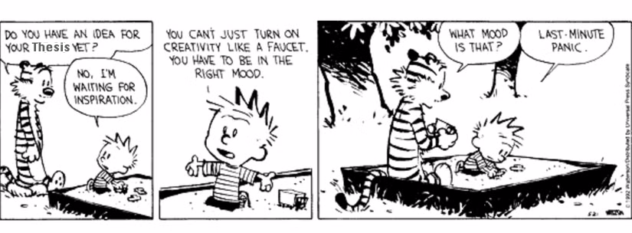
Vincent’s last 6 months
Your weekly dose of ”huh, interesting”
Special– for NBIO 207A, data analysis
Check speaker notes for comments and feedback from in-person discussions
Vincent’s light commentary on slides
Notes:
For don- Monday after the break– give him a presentation wherein I make the case that we see interesting and reliable intra-state dynamcis

Slide 2
What type of input am I interested in?
Any ideas to do with how to test hypotheses I’ll present soon
Holes in my analysis
Holes in my theory
Ideas on what I might be able to do to:
Make my science and statistics more rigorous
Proof my pipeline
Any skepticism you may have
Quantifying the existence of the dynamics I’ve identified (as vibes-based science don’t cut it)
Other notes (eg. anything)

Slide 3
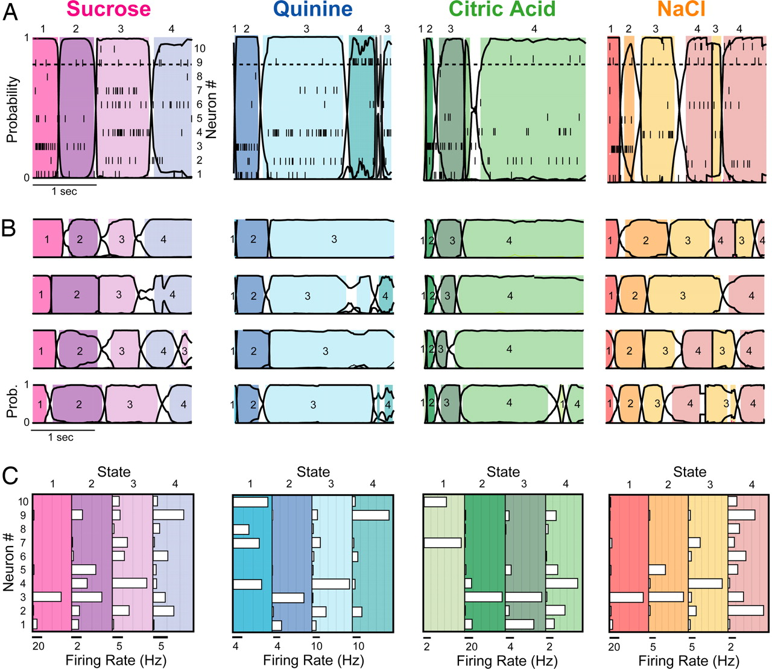
Intra-state dynamics: A brief overview
A constant emission HMM would assume:
Constant emission attractor states
Which would indicate intra-state spike trains are largely flat
This is likely simplistic
Intuitively, consider: neural processing needs to be happening somewhere
A
B
C
D
Spike trains do not appear to contain constant firing rates
A) Coherent state sequence in representative GC ensemble response to sucrose during a single trial (Jones et al 2007). Neuron spike trains plotted within spikes. Non-constant spike trains circled in red and shown in B, C, and D. Changepoints inferred via constant-emission Hidden Markov Model. Epochs 1, 2, 3, and 4 are referred to as detection, identification, palatability, and decision states respectively (via various Katz lab papers).

Slide 4
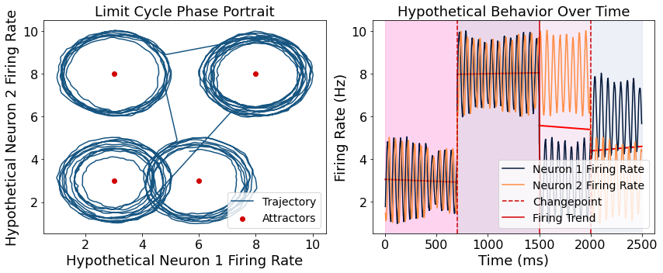
What type of dynamics? (theory)
We believe we’re looking at a non-linear system, which we have evidence for (will be shown).
Specifically, we hypothesize the network we’re working with non-linear attractors (see example of limit cycle below)
Probably NOT a limit cycle

Slide 5
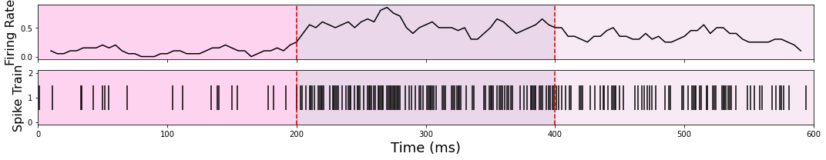
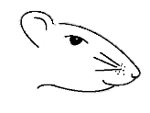
Brief slide on methods
Suc
NaCl
CA
Quin
Inferring firing rate from spike train– rolling window (very basic; 250 ms window with 25 ms step)
Dimensionality reduction:
PCA– only really useful for linearly correlated data (?)
Autoencoder RNN (block diagram below)– able to capture non-linear dynamics
Data acquisition: Sucrose [0.3M], NaCl [0.1M], Citric Acid [0.1M], and Quinine [1 mM] were delivered directly onto the tongue of female long-evans rats in a pseudo-random order using an intra-oral cannula. Extracellular recordings were taken from GC while tastes were delivered.
Original Input Data
Low-Dimensional (8 dims) RNN
Encoding Step
Reconstructed Data (should be identical to input)
Decoding Step

Slide 6
What am I currently able to argue to you?
What I am arguing: that interesting, non-linear dynamics exist in GC between epochs
I have demonstrated this on a single-neuron basis
Working on doing so on a population basis
(input here would be great)
What I may be able to make a claim about: The *general* characteristics of these dynamics, including some theories as to what’s what
What I am not yet to the point of making a claim about: Specific classification

Slide 7
The question I’m trying to answer right now
I’m focused on proving non-random and state-specific dynamics. I have basic descriptive stats for single-neuron. Doing the same for the multi-variate states I’ve shown you can be done (eg. multi-variate t-test); rigorously proving this is more involved
This is what I’m stuck on
The latter part attempting to test rigorously that the pattern of activity in one state is different from other states.
- Handling noise (proving these dynamics are not noise) is also part of this
First, some background:

Slide 8
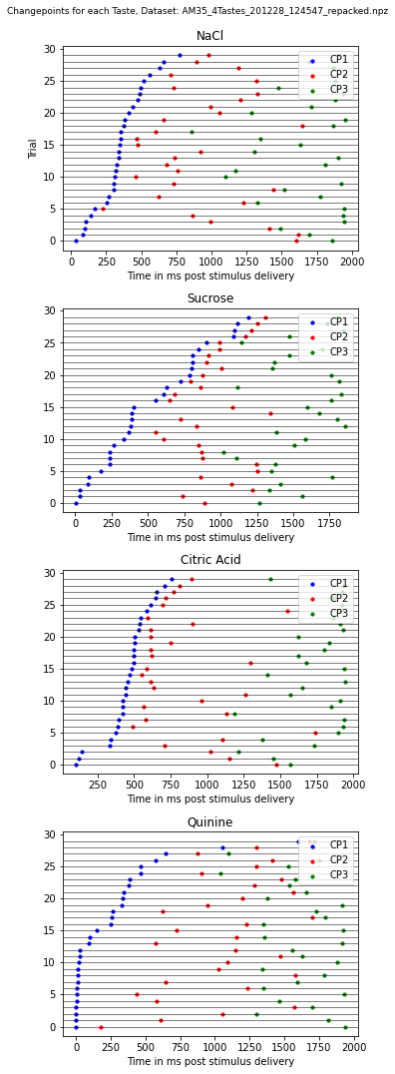
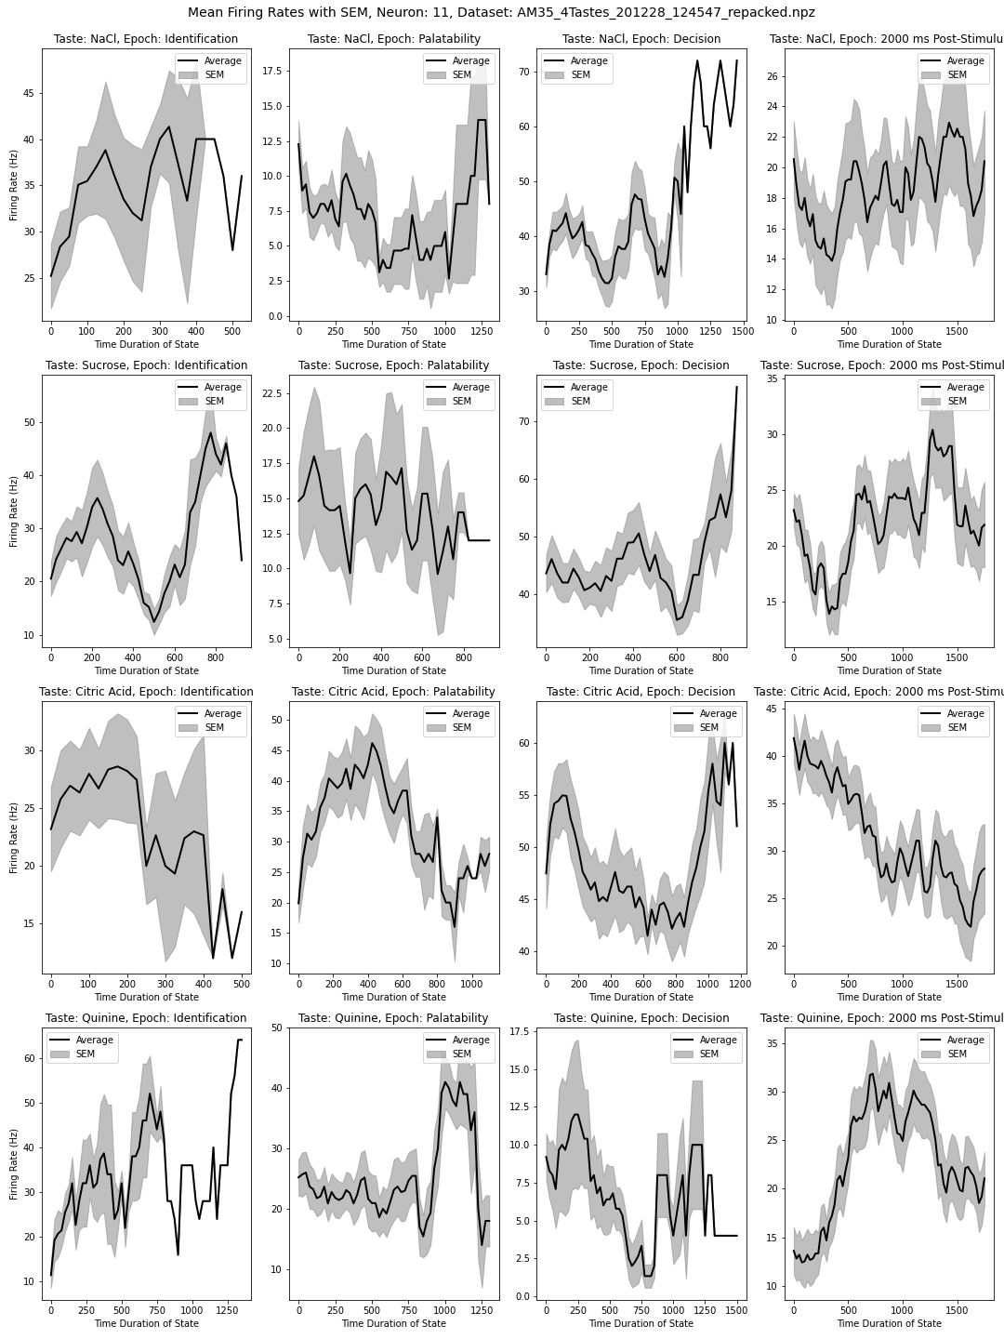
Starting with 1 neuron across trials-- What’s the deal with SEM duration?
Left: Mean firing rate across all trials for a single neuron; standard error of mean mapped around
Uninterpolated data
Right: timing of state transitions across all 30 trials for this one neuron. This variation is a feature, not a bug.
Hypotheses:
Nonlinear dynamics present (multiple different types, so it seems)
State durations are important – Positing that these reveal the time it takes the population to reach completion in processing
Mean firing rate and standard error of mean across trials for one neuron (30 trials)

Slide 9
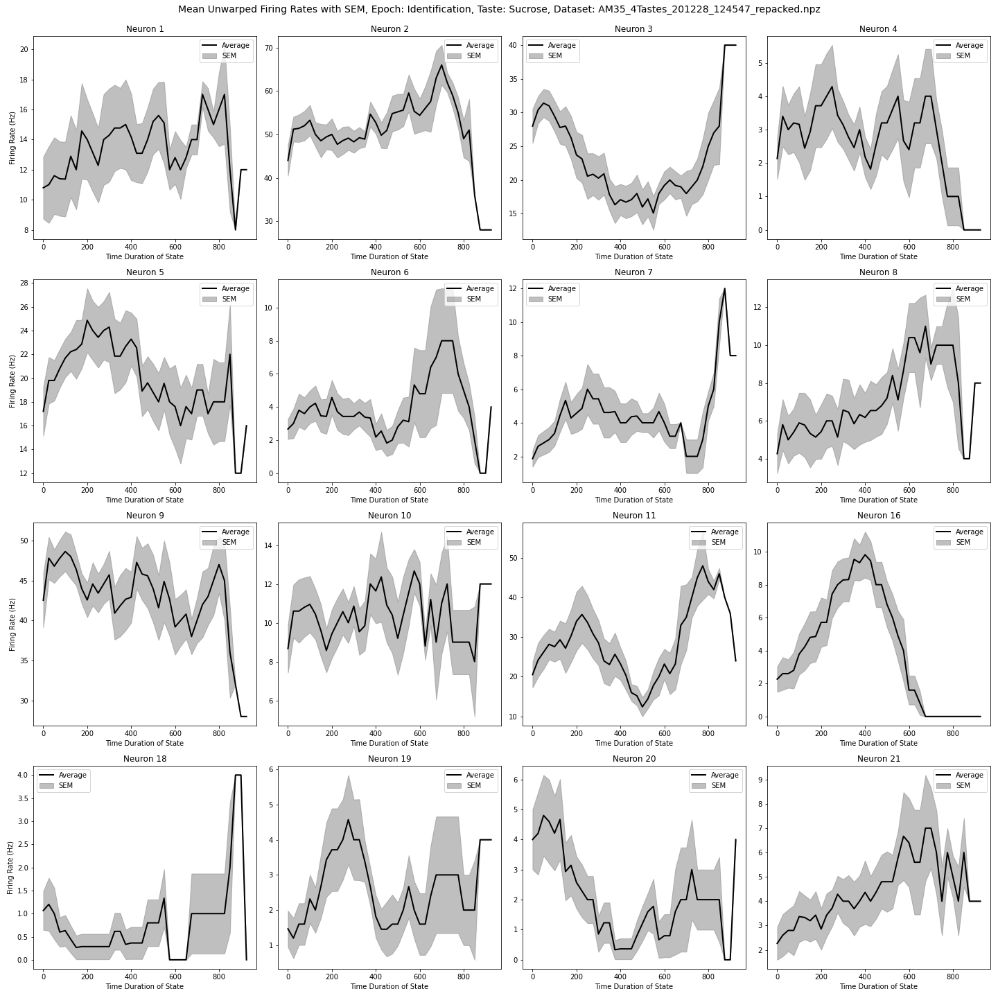
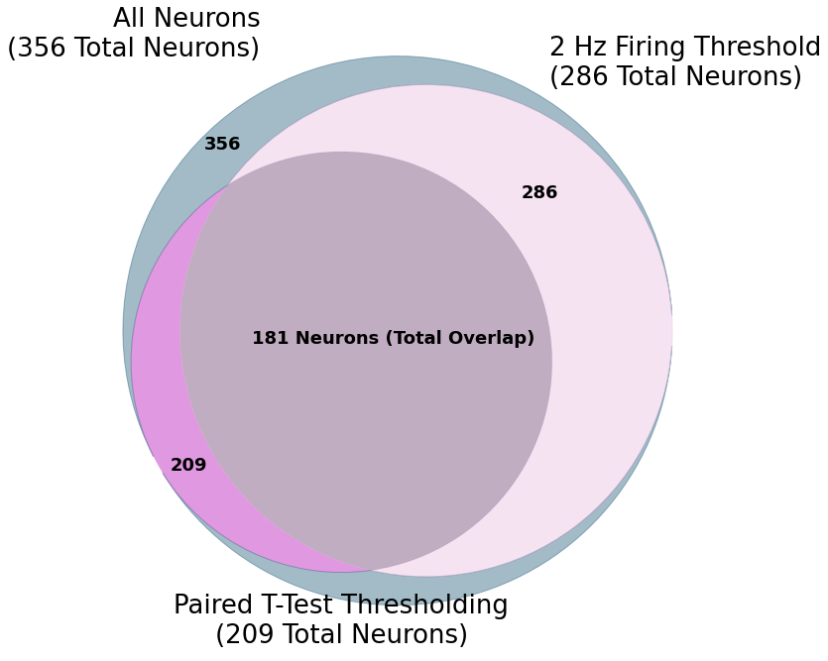
Many Single-neuron evidence for dynamics (one taste)
Large amounts of data: Thresholding via paired t-test (alpha = 0.05) and 2 Hz minimum frequency reveal sustained and dynamic intra-epoch firing is present in a large subset of the neurons across all datasets (n = 17). Thresholding allows us to filter down to neurons with firing rates more amenable to observation of dynamics.
Representative sample of single-neuron trial-averaged firing rate over time for a single stimulus and single epoch (sucrose, identification). Standard error of the mean plotted in grey around trial-average line. Distinct neuron-to-neuron differences in dynamics seemingly appear, suggesting multiple attractor paradigms may be present within a given epoch for a given population.

Slide 10
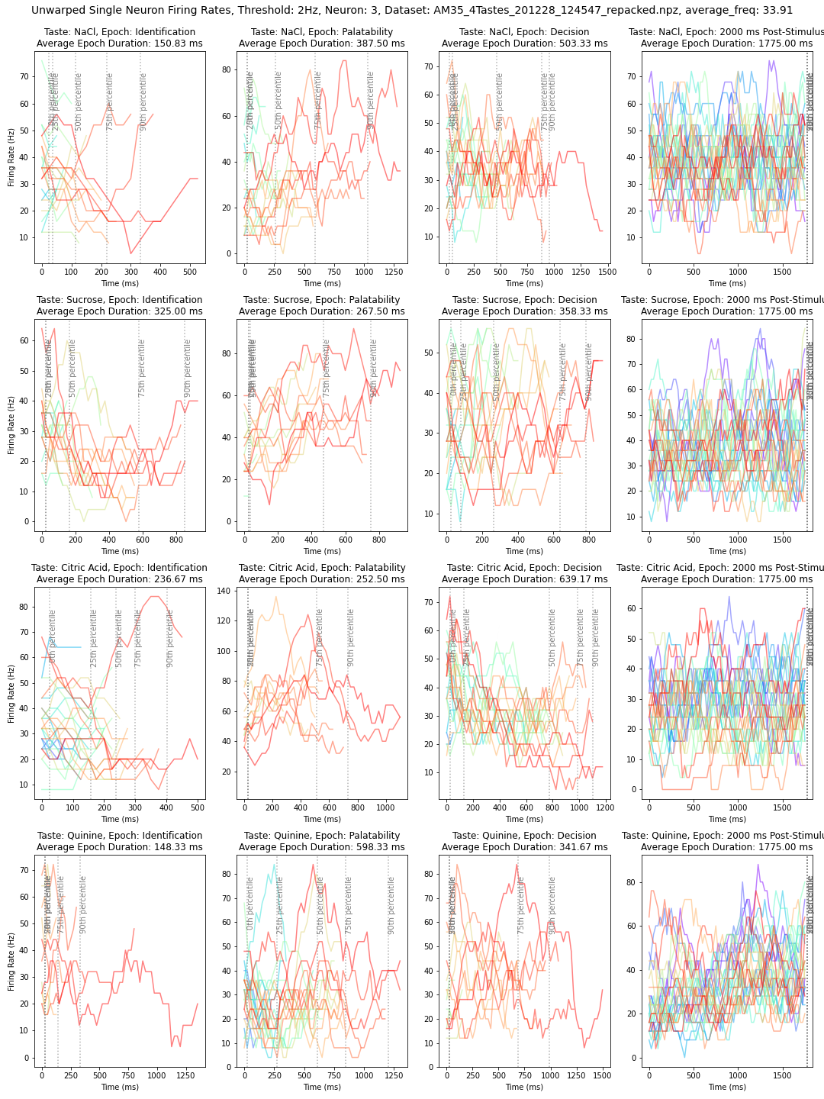
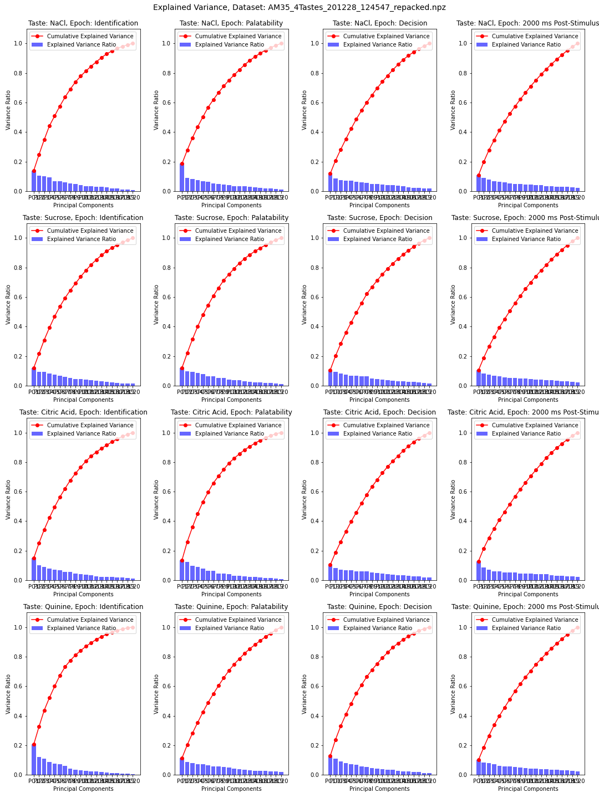
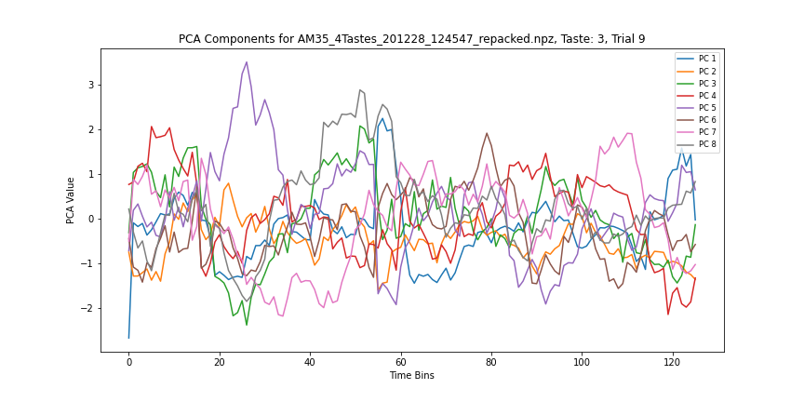
Reducing dimensions: noisy data, nonlinear data
Left: example of a single neuron’s firing rate, across all trials, across epochs (cols) and tastes (rows); you can see how noisy it is
Bottom: attempt at expressing population behavior via PCA for one taste and one trial. They all look like this.
Right: The real issue with using PCA on this data: poor correlation.

Slide 11
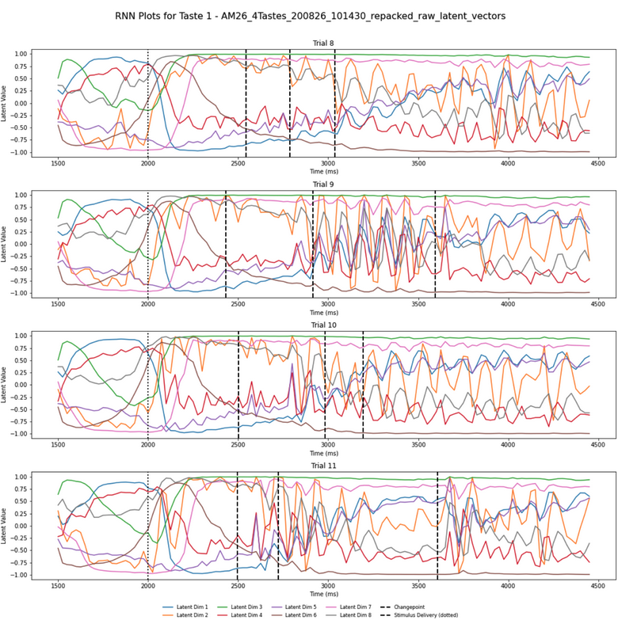
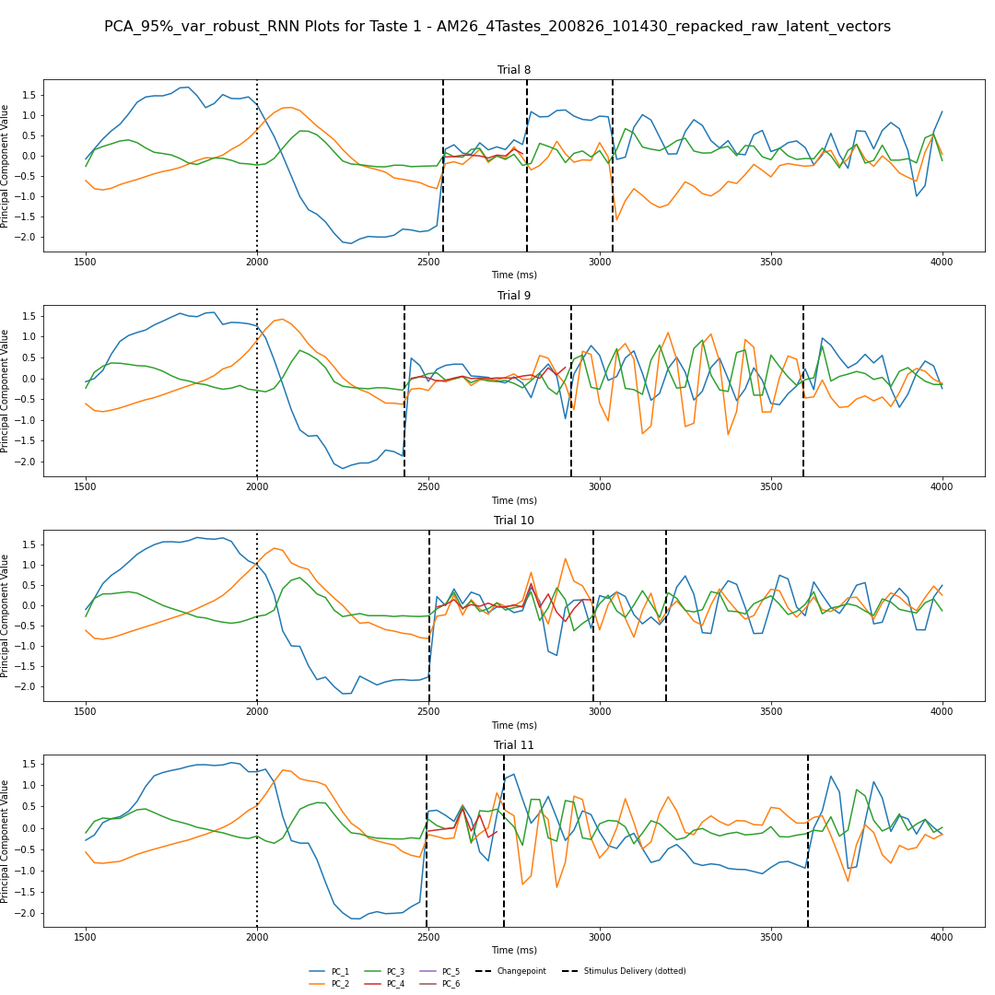
So let’s do non-linear dimensionality reduction
Example of reduced dimensions for 4 trials of one taste; 8 latent dims inferred
RNN trained on the whole dataset; taste-by-taste (and trial by trial) basis – Considers all neurons
Seem to be getting somewhere
Note the appearance of oscillatory dynamics (I’ve checked; this is not a fluke or an artifact so far as I can tell)
RNN Inference
PCA (>95% var) on RNN inference data

Slide 12
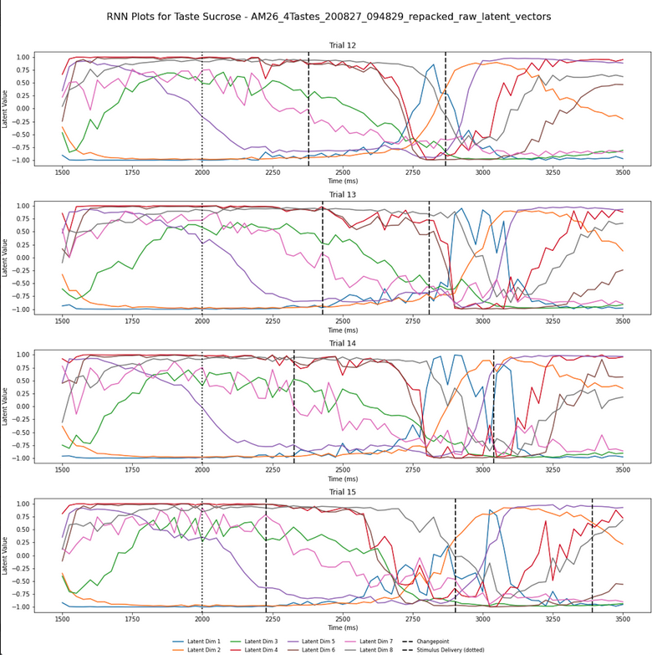
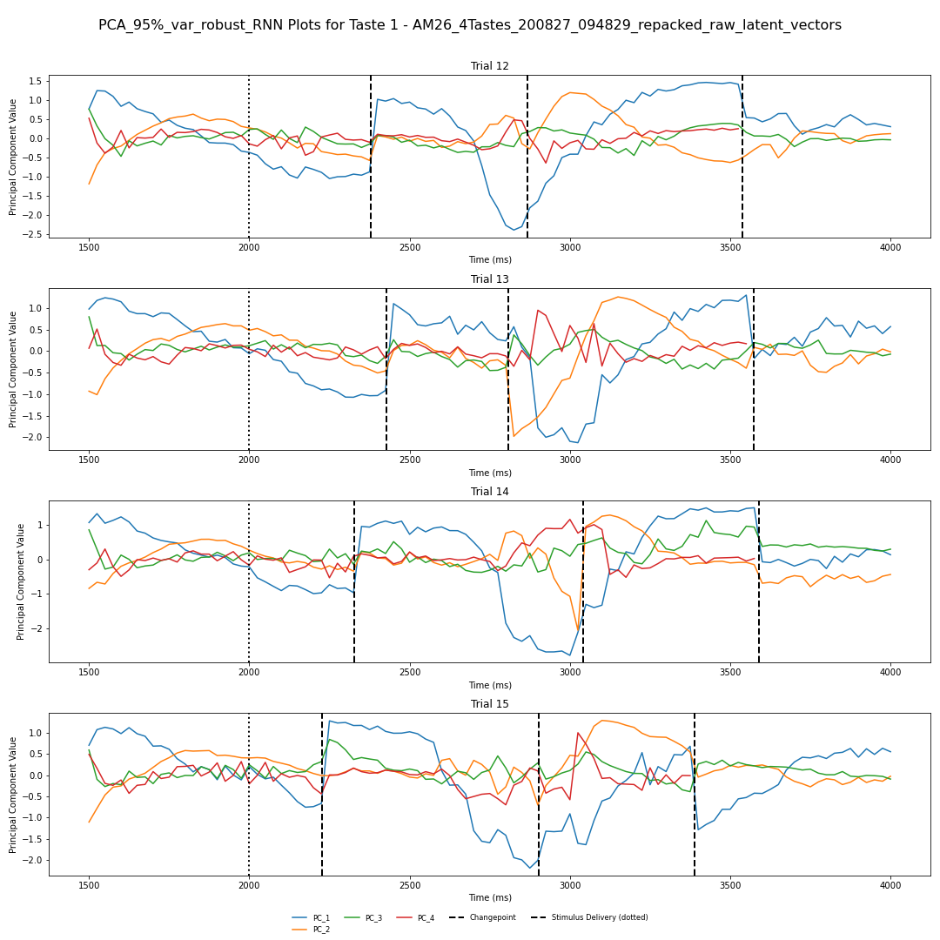
What we’ve seen: Analysis on RNN data – Right is RNN output Left is PCA on a trial-by-trial basis of the RNN data
Another example of this– note especially the sharp change in latent dynamics right at inferred changepoints, which is expected
Notes:
Also do the RNN PCA transition aligned – both raw latents and PCA latents– chop em up
Take a window around the transition (top of list)
2 methods:
what’s happening within a state
What’s happening around a transition (250 MS before and after) -- RNN and PCA of RNN latent -- windows around the transition to see how well latents align with transitions
Following this what the latents are doing within each state
Epoch-aligned: start to end of the epoch
Be careful of doing PCA on every single trial– not guaranteed to get that on every single trial because there could be drift trial to trial – start w/single PCA across trials (concat all trials then do PCA – stack along time; do PCA on this)- this should give what we want assuming there ISN’T drift across latents – once PCA is run do a transformation back into trials and plot the way we’ve done so (~95% var, if a lot then keep the top 5 and record how much variance each of those components explain) – I want to explain the cumulative variance from the latents and from the raw firing rates

Slide 13
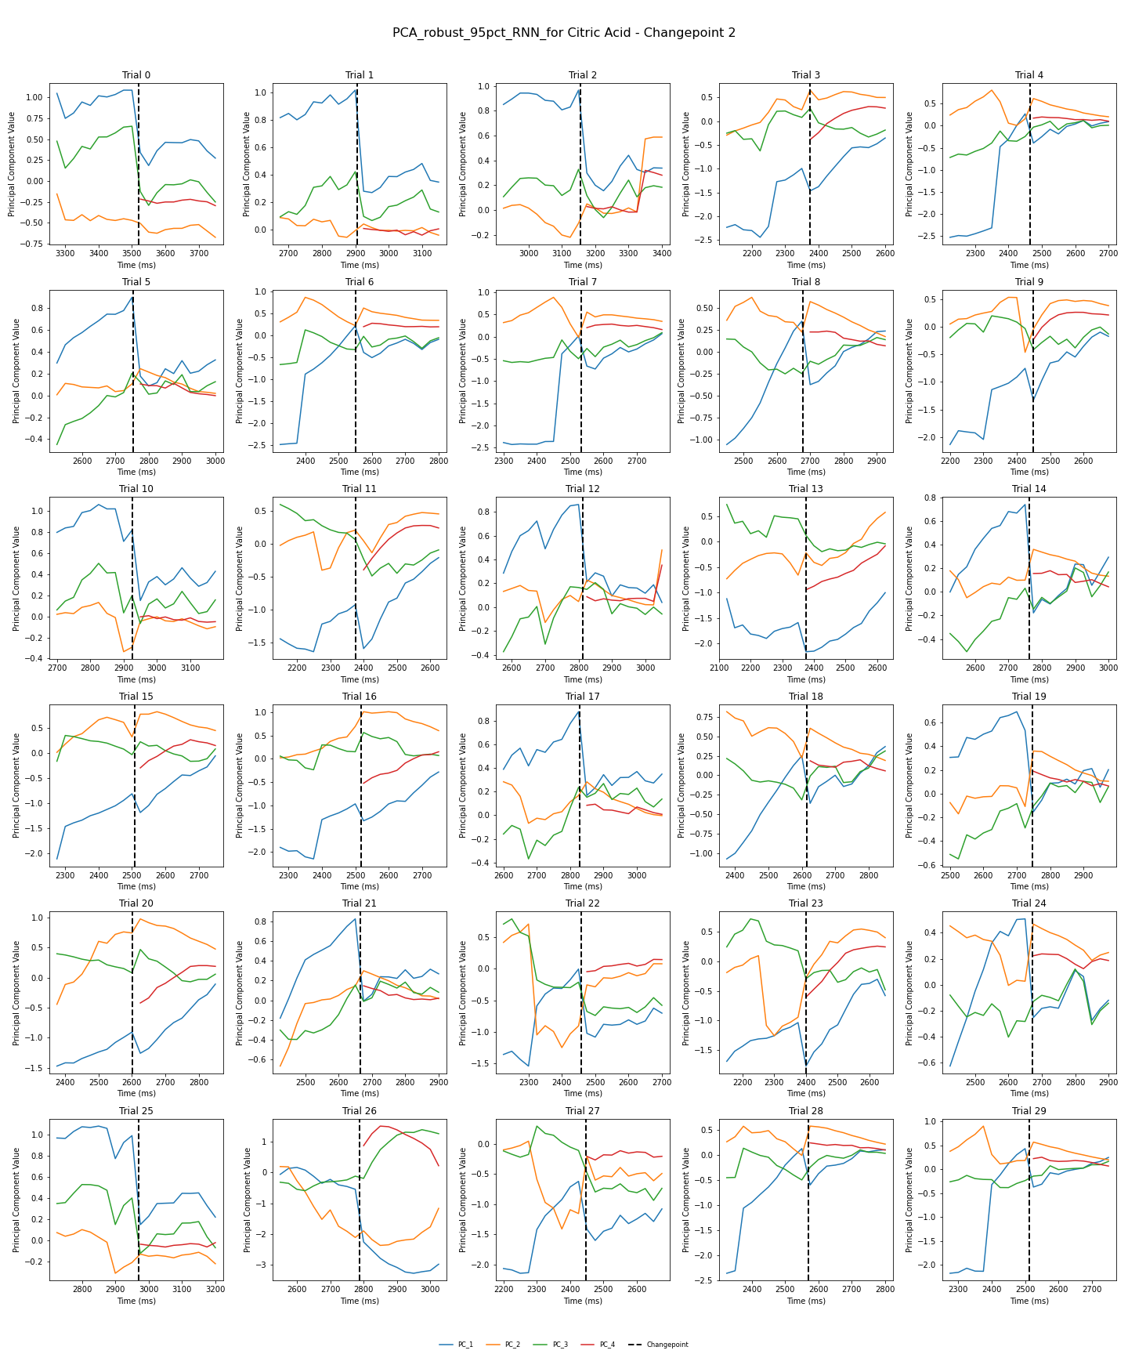
Looking at behavior before and after CP Data: PCA on RNN across trials rather than trial by trial Citric acid, CP 2 Thresh. Vectors To 95% of explained variance (dataset 200827..)
Strong evidence of regime changes across all trials
Note; we see the addition of the red latent after the changepoint in every single trial for this particular animal.
Looking for:
consistently sharp changes in latent behavior around the changepoint
Any potentially conserved dynamics across trials
I’ve manually tried to color-code certain trials by pre-transition dynamics I thought were similar-looking
There were immediately 3 dominant-ish looking groups that popped out to me
Notes:
Abu want a fig where a single subplot is one latent vector across ALL trials for one transition– 8x3 subplots (8 vectors, 3 transitions)

Slide 14
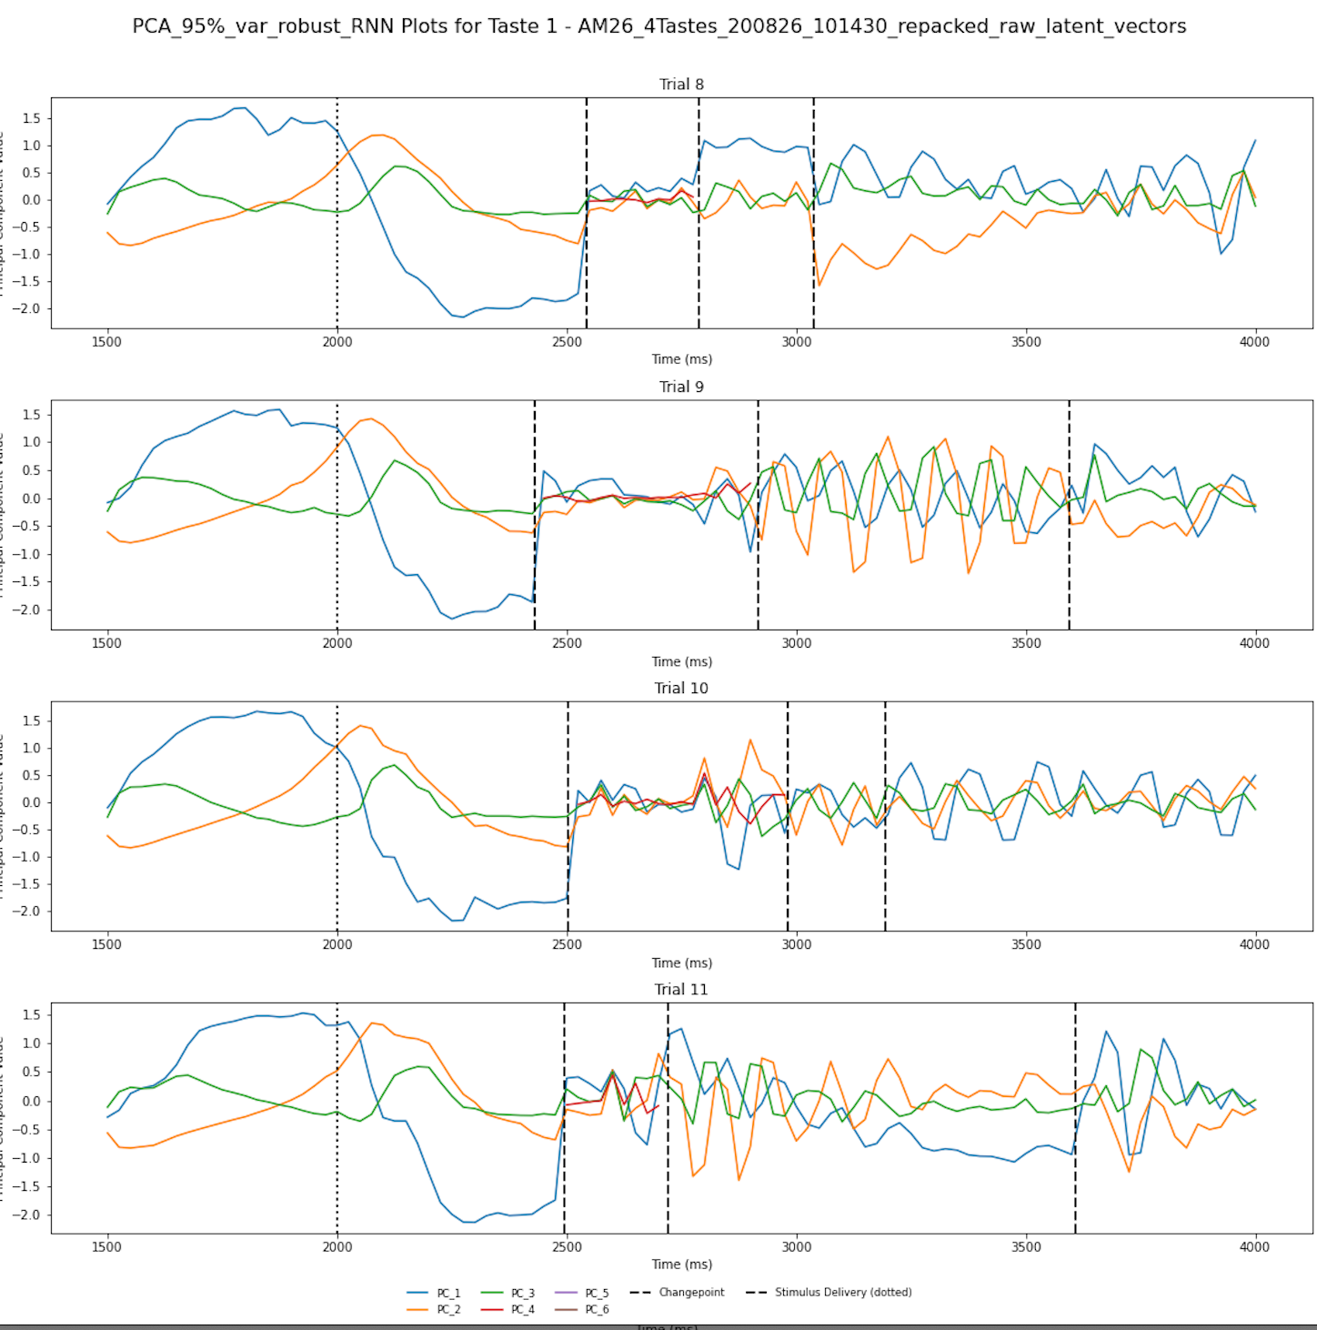
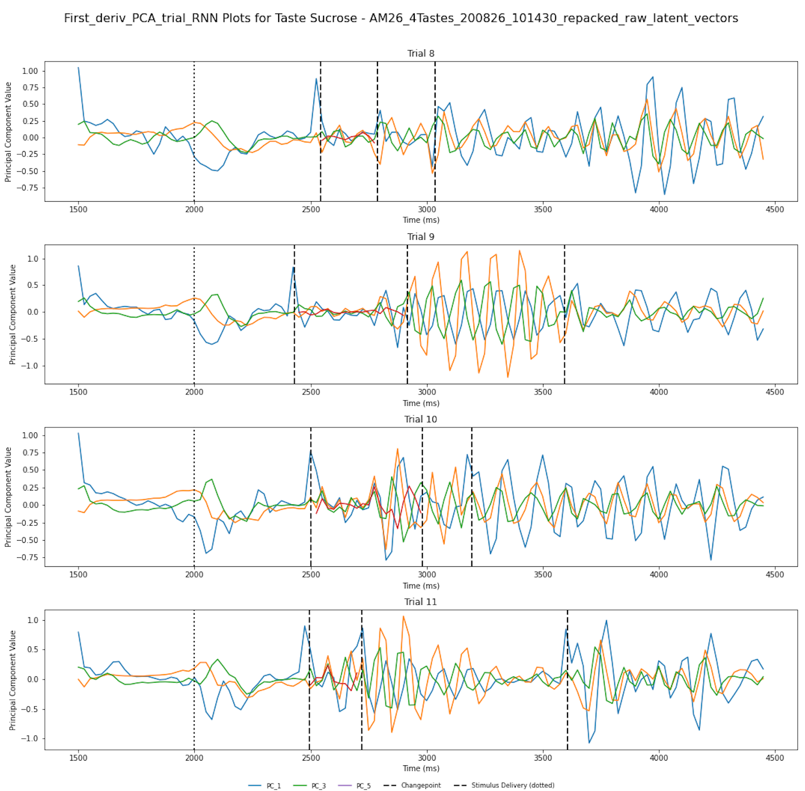
Left: Latent vectors inferred via PCA from RNN trained on spike trains.
Right: First Derivative of this data. (Further commentary in speaker notes)
Notes:
Left– Latent vectors inferred via PCA from RNN trained on spike trains for sucrose. Each sub-plot is one trial; each vector represents a principal component. Stimulus delivery marked at 2000 ms with a dotted line. Make special note of sharp changes at changepoints (bold, dashed lines). Note that PC 4 is only present in the first epoch.
Oscillations are present.
Right: The first derivative (aka first diff; these are the same thing) of this data. Setup of plot is exactly identical to left. Note that the scale of the y-axis is in general lower in magnitude than that of the left plot. This measure clarifies some of the oscillatory stuff we’re seeing, including what appears to be the extinction of oscillations prior to a changepoint (see trial 11, bottom right).
I also want to point out what appears to be in/out of phase behavior in the right plot– see specifically, the second epoch (2800-3600 sec) of trial 9– all 3 vectors appear to me akin to sin/cos functions, with green and blue vectors notably almost entirely out of phase with each other (but at the same frequency) and the larger yellow vector operating overtop at a similar frequency, but in-between the phases of the other two vectors.
Notably, these vectors fall largely back into phase with each other following a changepoint at 3600 sec. You can see other examples of vectors in and out of phase with each other in trials 10 and 11 on the right plot as well.

Slide 15
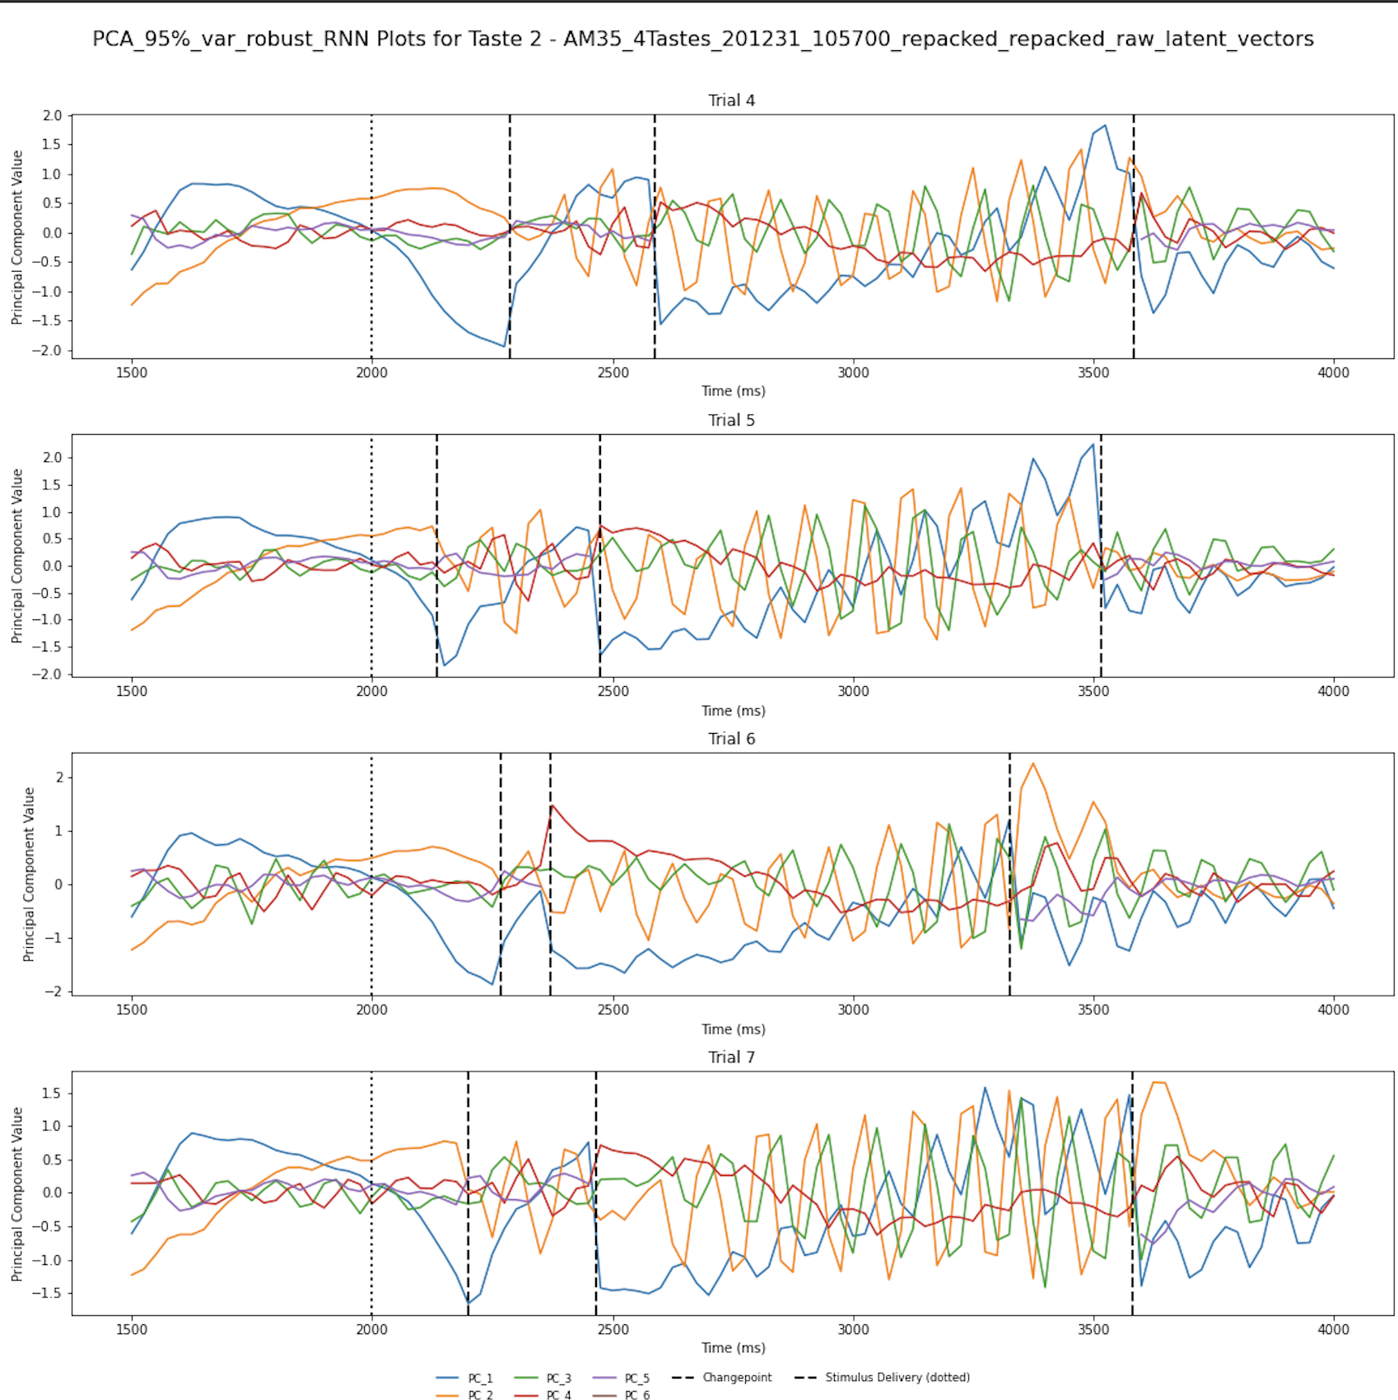
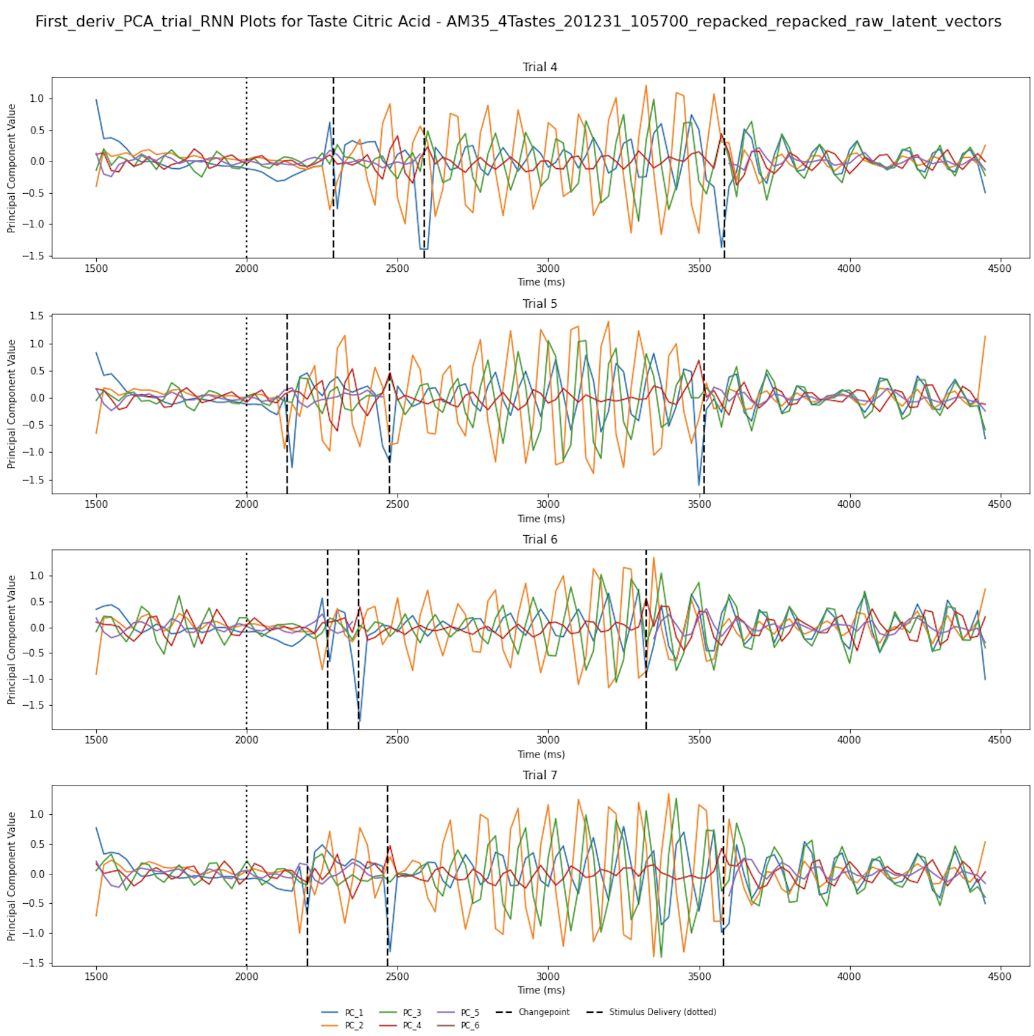
One more pretty pic– first deriv. on right
Notes:
A similar visualization as before, wherein I further illustrate an observation to do with oscillatory dynamics.
Setup:
Left– Latent vectors inferred via PCA from RNN trained on spike trains for sucrose. Each sub-plot is one trial; each vector represents a principal component. Stimulus delivery marked at 2000 ms with a dotted line. Make special note of sharp changes at changepoints (bold, dashed lines).
Right: The first derivative of this data. Setup of plot is exactly identical to left. Note that the scale of the y-axis is in general lower in magnitude than that of the left plot.
How does this help me?
For the sake of quantification, I’m noting that the frequencies of these oscillations are largely conserved. This will help.
Why did I include this?
These are some kick-ass plots if I do say so myself. Every single trial for this taste from this animal looks like this, it’s pretty incredible.
These are excellent examples of what I was arguing in the previous slide: I stated “Similarly, by filtering [non-oscillatory] data, we can interrogate a related question: will oscillatory dynamics align with each other when warped, OR, are we seeing a consistent frequency regardless of state duration, with transitions dictated by a dampening of amplitude of one or many vectors? (as most clearly seen in slide 3, bottom right trial, second epoch). The above right plot I argue supports my hypothesis that, at least to do with oscillatory dynamics, state transitions seem to align with drastic changes in amplitude of oscillations rather than changes in period, frequency, or wavelength. Note especially the second epoch (2600 ms- 3600 ms) of trail 4 on the right– we can see oscillations getting progressively larger in amplitude before promptly going to extinction at the changepoint.
This plot (especially pre-stimulus delivery) also has one or two latent vectors which are largely not strongly oscillatory– see PC 4 (red). Though it exhibits oscillations in later epochs (especially when considering the first derivative (right), it’s important to note that the overall trajectory of that vector in the left plot (non-differentiated data) is largely consistent across trials, notably crossing over the blue vector at around the halfway point of the largest epoch. While both latents exhibit oscillations, the trajectories of the vectors themselves may very well also have something to do with state transitions.

Slide 16
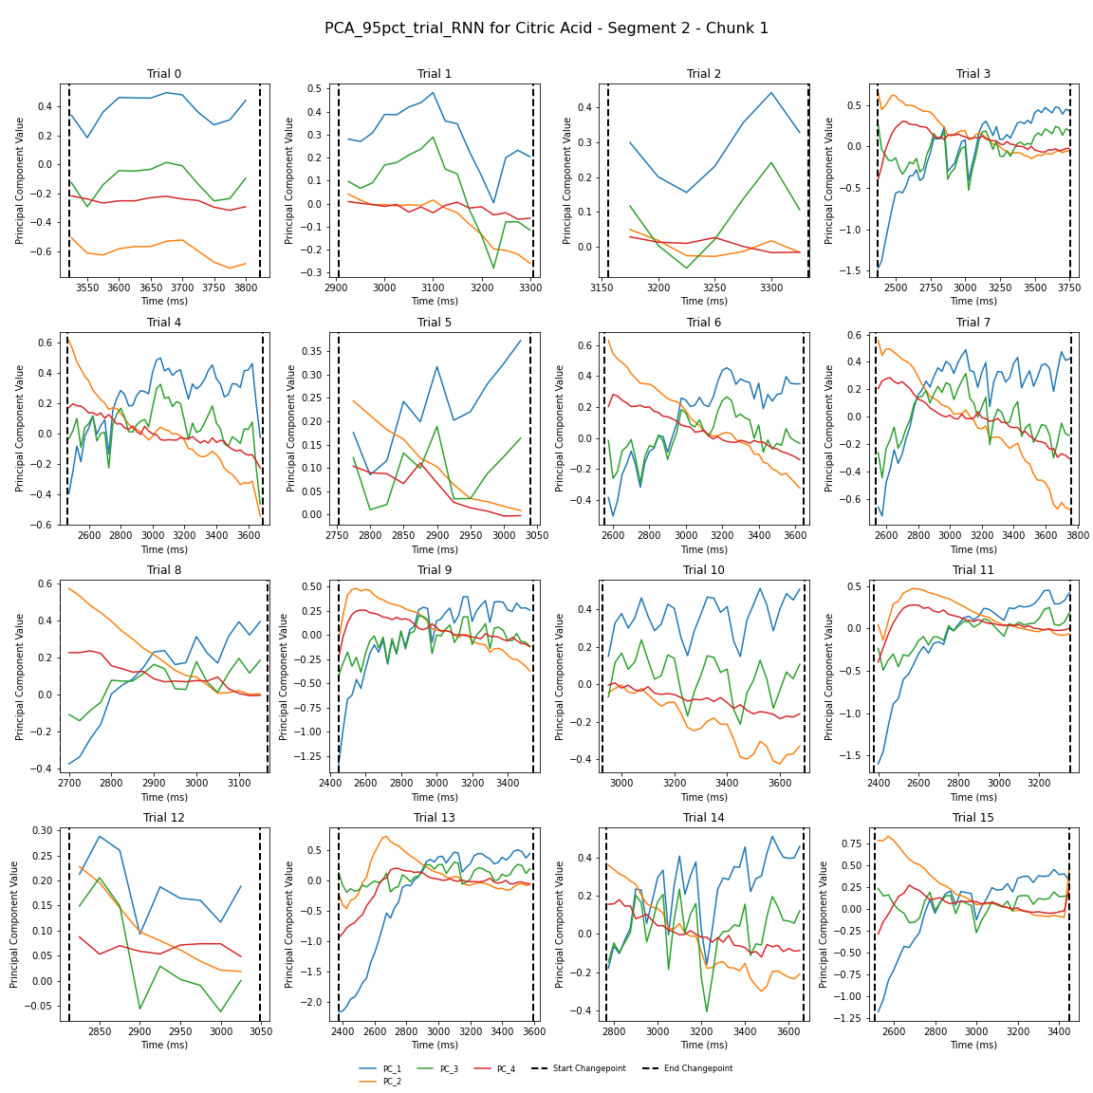
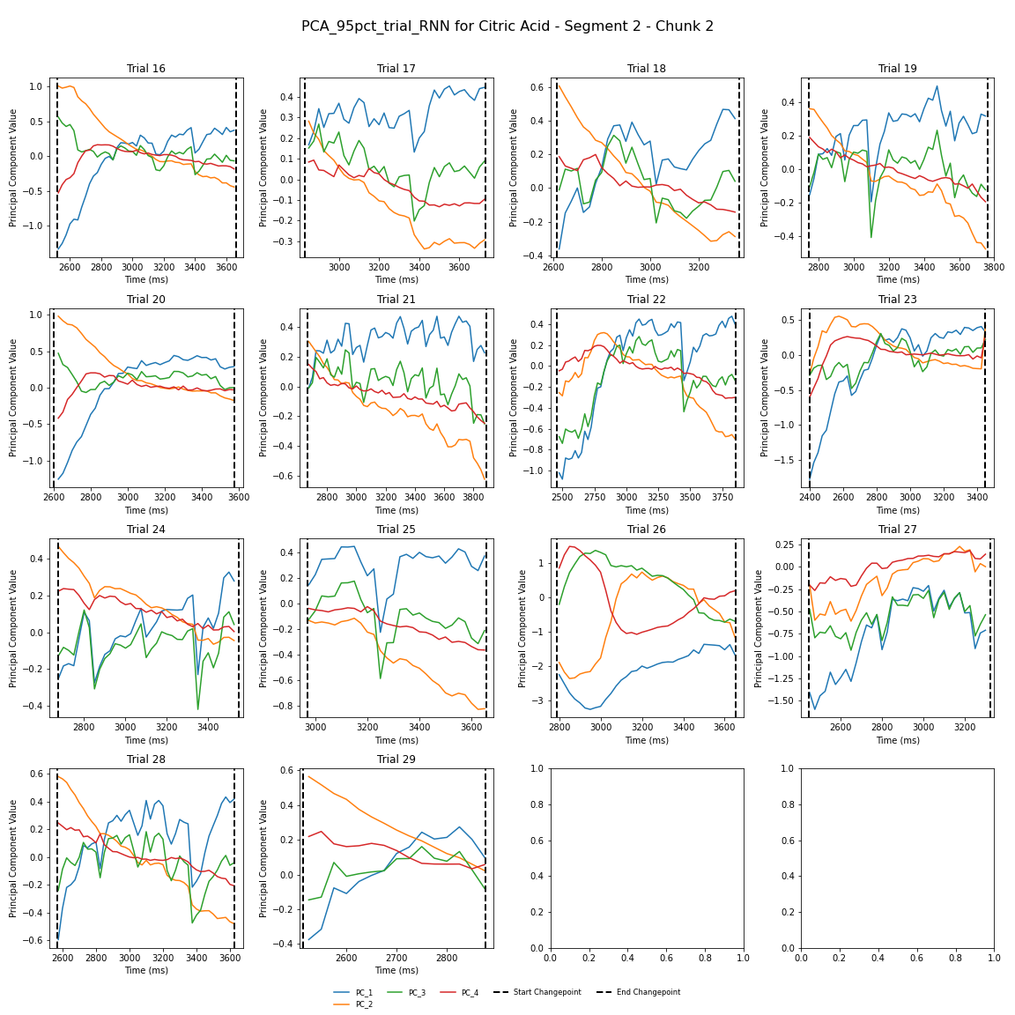
What I mean by “classifying analogous pairs”. All trials of one taste, as fed through these steps. Same data as before (200827)–
Looking for: what are the dynamics doing? Do they seem to be stretching or shrinking appreciably?
To don’s hunch: It seems like there are more than a few trials that exhibit largely (ish) the same behavior-- see boxed trials, color coded.
Note: Timeframes vary wildly– from 300 ms (trial 12) to 1200+ ms (trial 3). Todo: figure out how to better identify these similarities
Notes:
We need to figure out a better way to cluster these– once we have the figure of latents across transitions across all trials (see previous, which will show that there are transition-aligned dynamics), we can then ask how we can cluster what we see here. Perhaps cluster/sort along a couple vars– Plot all trials for the latent, perhaps sort by length – try the interpolated/uninterpolated stuff agai; Under *some* assumptions we could just cluster these-– but there are questions:
- Are we trying to cluster at the single latent level, multilatent? Deal with differing lengths and from there it can be pretty straightforward. Similar to clustering whole trials (which has the bonus of that they’re all the same len)
We still very much want to do interpolated/uninterpolated side by side; if we need to do expediency we may just do one or the other– but we should not pre-suppose that doing one vs the other is the better way to do it.
Note to Vincent: You made a real mistake forgetting to put the dataset name in the title of the figures this time round bud…that’s gonna come back to haunt you; you should fix that shit– otherwise you’ll never be able to find what figure was interesting.

Slide 17
Questions I’m trying to answer:
First question: do dynamics exist? I feel as if I’ve demonstrated they do
I have basic descriptive stats for single-neuron dynamics. Similarly, I have data for the population.
This get into the idea of analogous pairs: can I identify and quantify repeated characteristics?
Do I run something like a multi-variate t-test? rigorously proving this is more involved
This is what I’m stuck on
The latter part attempting to test rigorously that the pattern of activity in one state is different from other states.
Dealing with these different state durations – stretching / shrinking
Phases of oscillatory stuff?
Quantification?
Testing against shuffled data: I am doing so, but does it matter if I can show different states that have oscillations and which do not?

Slide 18
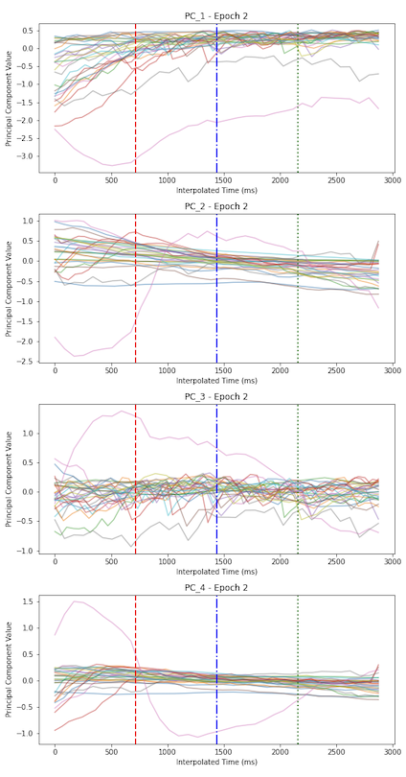
Interpolating all these trials: womp womp
The hypothesis with interpolation would have been that dynamics are effectively “grouped”
My working theory as to why this is such a poor result: PC 1 for trial 1 is not the same as PC 1 for trial 5 (as an example) – as each trial is similar, but as we’ve seen, clearly not the same

Slide 19
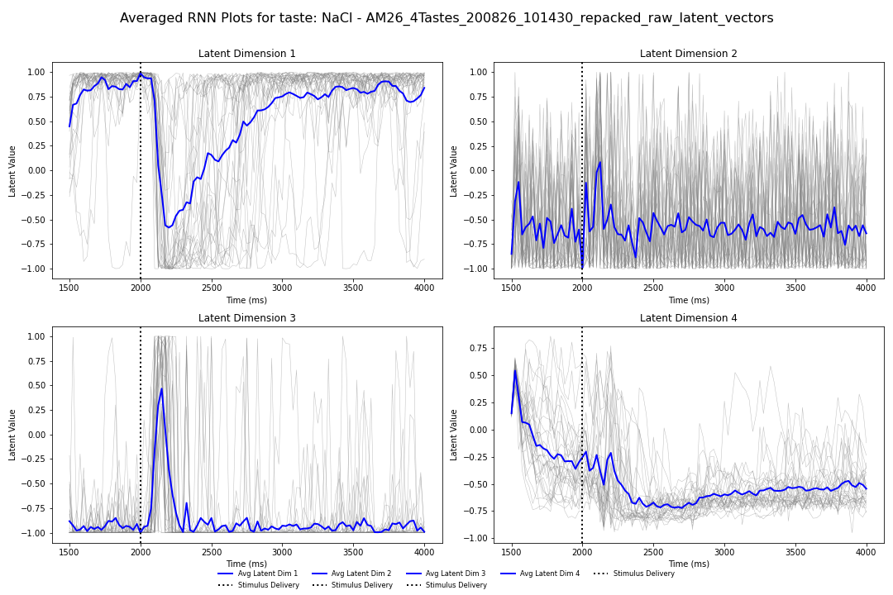
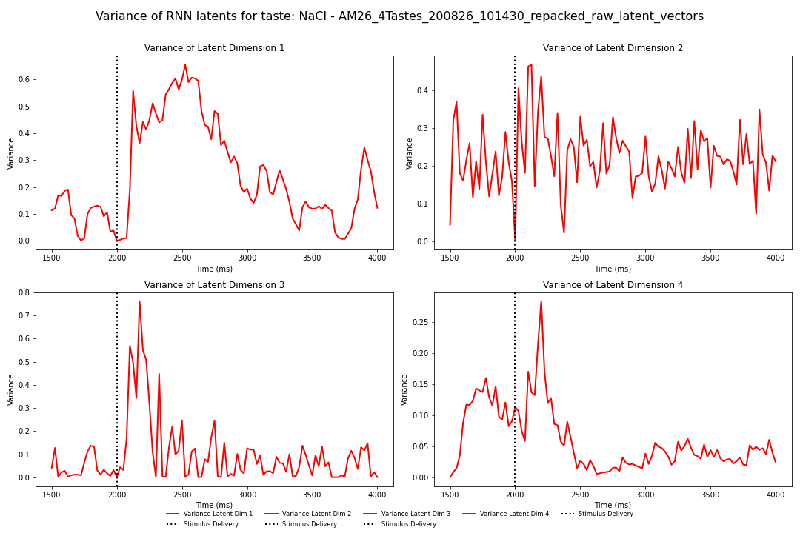
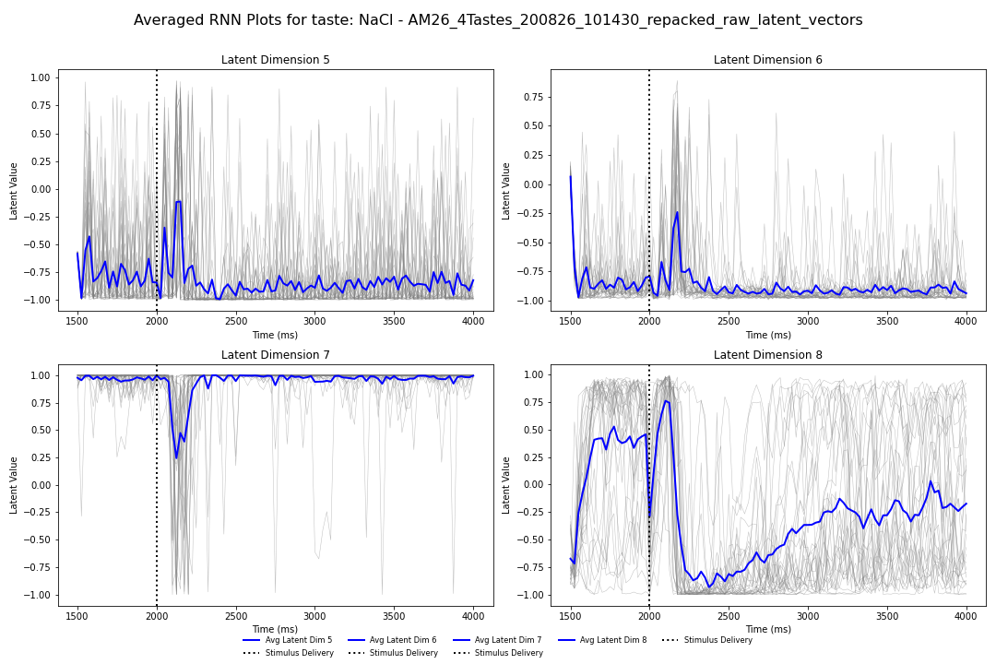
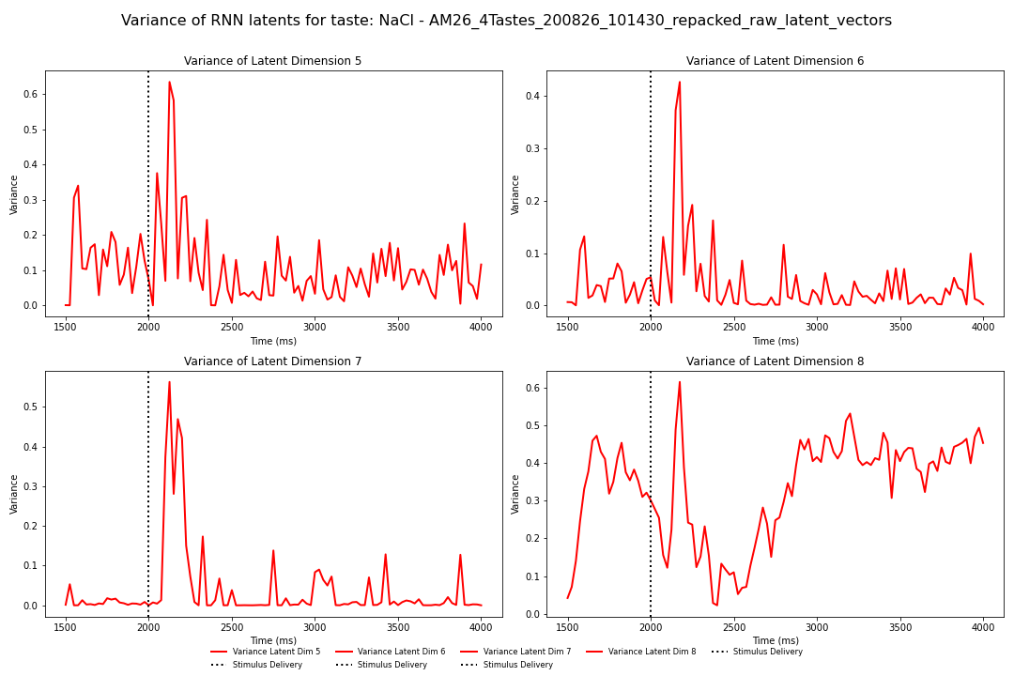
What are RNN latents doing over trials? – NaCl, Left: RNN trajectories, right: Variance of trials over time
What we see here:
Left is RNN trajectories over time with average
Right is variance of trajectories over time (NaCl)
Note: we see a very large spike in variance of trajectories immediately after stimulus delivery, after which the story gets… a bit more complex
Interpretation is not yet clear to me
Considering doing some wave decomposition or something
Notes:
This is honestly probably the figure that we would show BEFORE anything to do with the PCA inferred stuff; we can talk about single-trial lines and etc. There’s AN average structure and there’s trial-to-trial variability, moving on
Look into it more but this is back-burner compared to transition snippets and epoch snippets of the latents
Rather than plotting the latents and the average of the latents– let’s plot the variability of the latents over time – and if we get the variance measure and we start to see commonalties, then we start to see commonalities in the latents

Slide 20
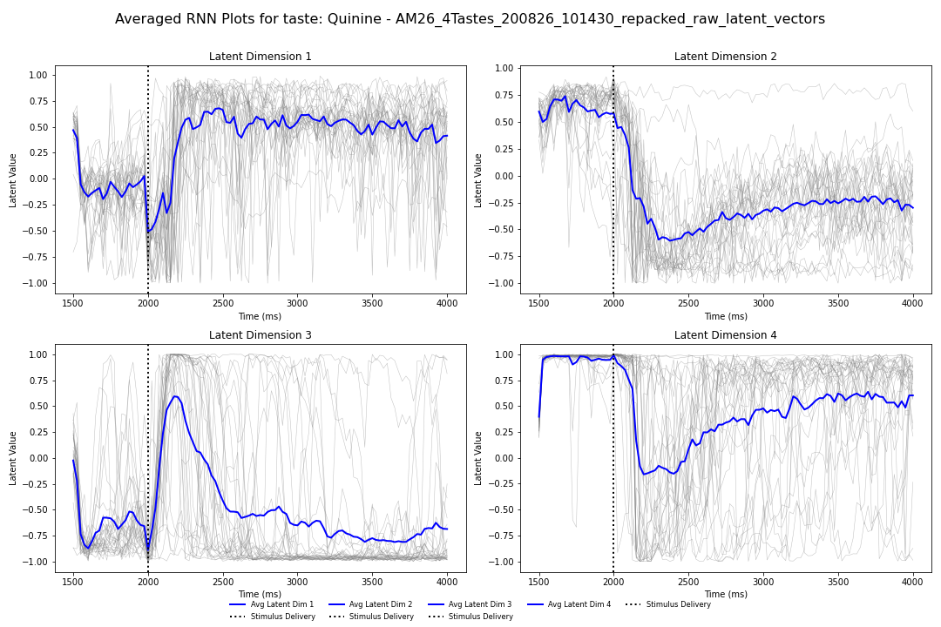
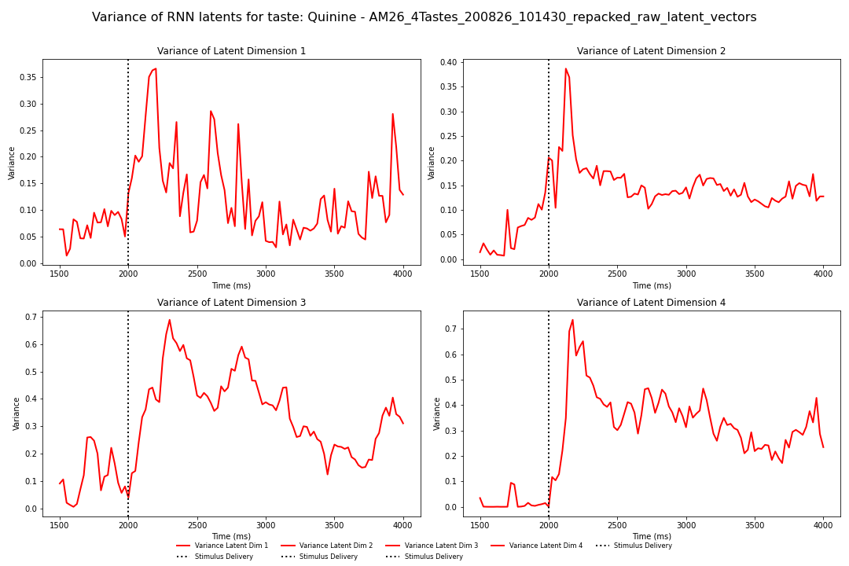
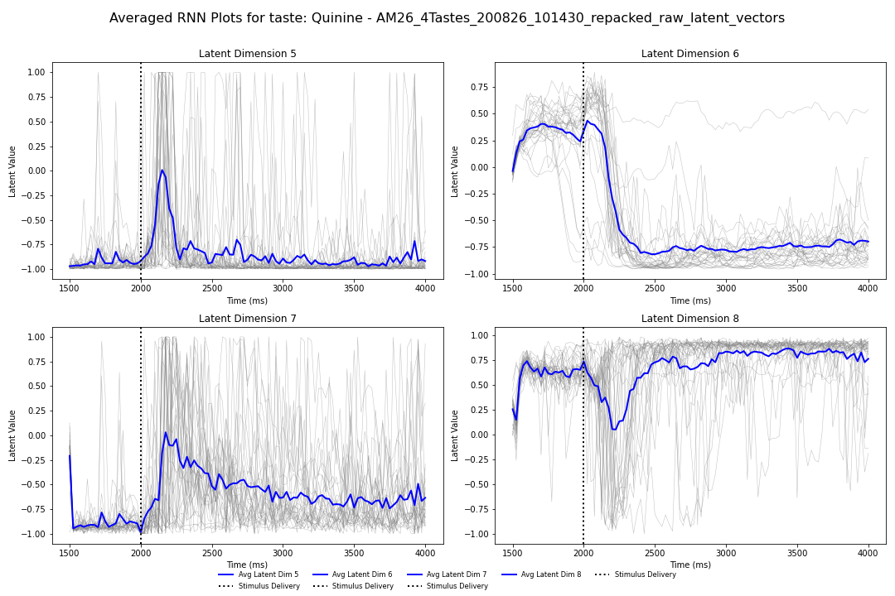
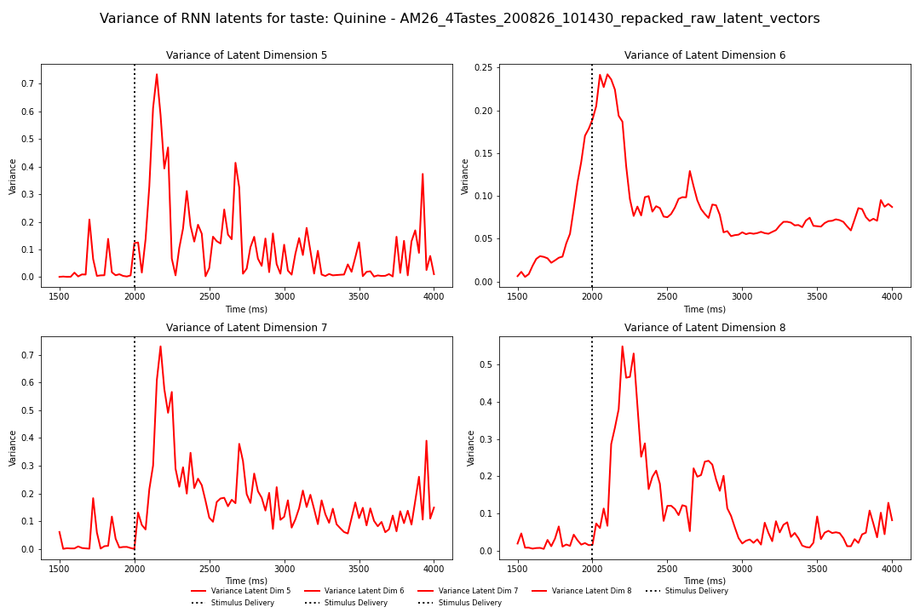
What are RNN latents doing over trials? –Quinine, same type of analysis as previous slide
What we see here:
Left is RNN trajectories over time with average
Right is variance of trajectories over time (quinine)
Note: we reliably see a large spike in variance of trajectories immediately after stimulus delivery, after which the story gets… a bit more complex (but generally trends down)?
There’s real variability in how the variance trends depending on the data
Interpretation is not yet clear to me

